Slide 1
Articulation Skills
With Special Reference to the Pronunciation of English Words

Slide 2
What are Articulation Skills? Why are they important to learn?
To articulate means : a) to express in words; to say or pronounce, (b) able to express thoughts and feelings easily and clearly, or showing this quality.
Generally, the expectation is that articulation of words and sentences should be such that it is clearly heard and understood by listeners.
Articulation involves clear pronunciation: It is the process of moving the tongue, jaws, lips and other organs of speech (articulators) to form speech units.
Therefore, to improve one's oral communication and to make it more effective, one is required to hone one’s articulation skill
A common observation: A person with good articulation skills is generally preferred over/to a person who cannot articulate properly.

Slide 3
The twenty six (26) letters of the English alphabet individually or in combination produce forty four (44) different speech sounds
It is important to learn to produce each sound clearly, because such a knowledge makes our speech better and more effective
Mispronunciation of sounds in any language is highly likely to lead to confusion and misunderstandings at times, for example, in English, the difference between the sounds of letter 's' in the words 'seat' and 'sheet' should be articulated clearly
Likewise, the vowel sounds in the words, 'bed' and 'bad' are different.

Slide 4
Correspondence between Letters and Sounds in English Language
There is no one to one relation between a letter and its corresponding sound in English language
Recall that: 26 letters in the English alphabet are used to represent 44 different speech sounds in English.
For instance,
The sounds of letter 'a' in the words ago, cat and call are all different
Additionally, the letter 'c' in the words camp, and century, and the letters ‘ch’ in chemistry and chef are pronounced differently.

Slide 5
International Phonetic Alphabet (IPA)
To avoid the confusion in letter-to-sound correspondence, International Phonetic Association introduced International Phonetic Alphabet.
There is one to one relation between an IPA symbol and the sound it represents. This means that one IPA symbol gives one sound unlike the English letters.
A phoneme is a speech sound. It is the smallest unit of sound that distinguishes one word from another. Since sounds cannot be written, we use IPA symbols to represent the sounds.
With the knowledge of phonemes, one can read the correct pronunciation of words of different languages including English.

Slide 6
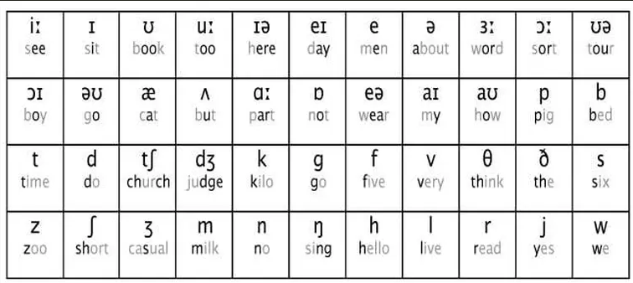
IPA Chart
Look at the following IPA chart that contains all 44 phonemes of English language. Each phoneme is tagged along with a word as an example. The highlighted letter(s) (in bold) denote(s) the sound of the IPA symbol written above it.

Slide 7
Classification of Human Speech Sounds in English Language
As we know that the English letters are classified into two categories:
(i) vowel letters, and (ii)consonant letters
Similarly, the English sounds are also divided into two categories:
(i) vowel sounds, and (ii) consonant sounds

Slide 8
Difference between Vowel and Consonant Sounds
When vowel sounds are articulated, the air from the lungs passes:
i. freely
ii. continuously
iii. through the mouth (oral cavity)
The vowel sounds can also be elongated easily. There is no obstruction by the speech organs such as teeth, tongue, palate, etc.
On the other hand, during the articulation of consonant sounds, it is vice versa. The air from the lungs has some obstruction.
During the articulation of sound given by letter 'b', the air is first obstructed by the lips after which there is a sudden release of lung air.

Slide 9
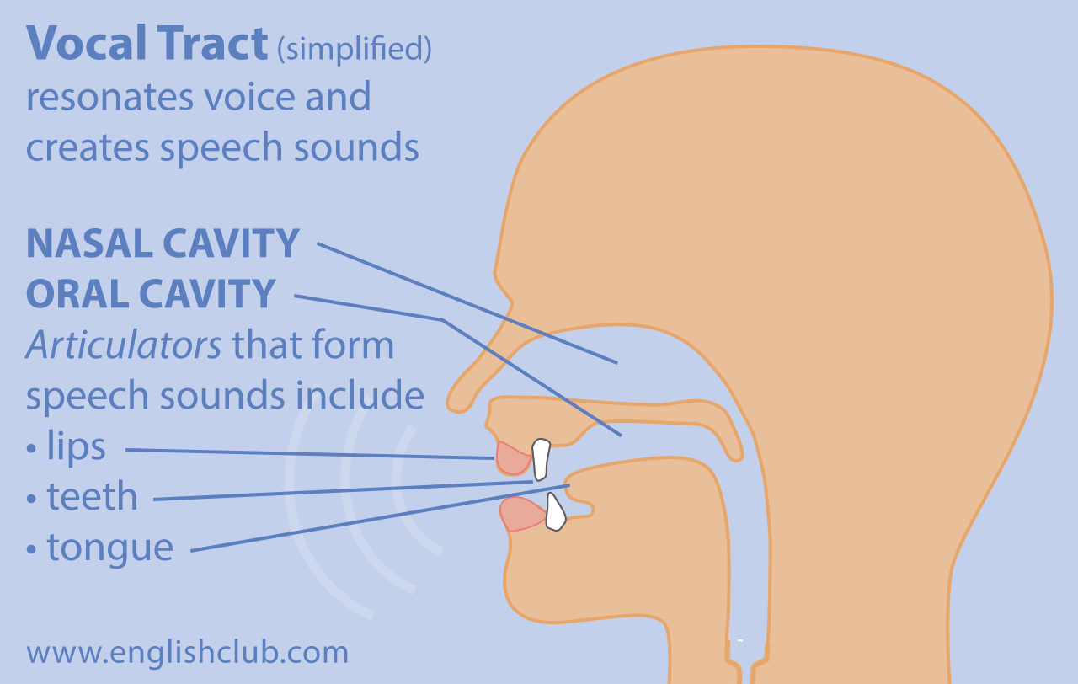
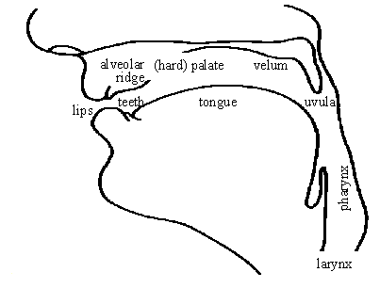
Diagram of Oral Tract responsible for speech production

Slide 10
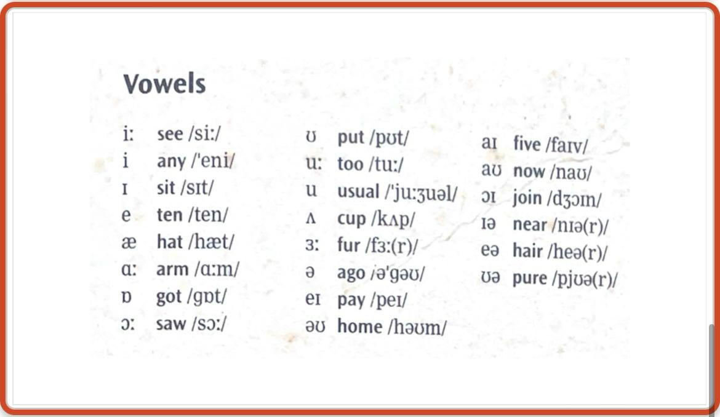
The following list contains the phonemic symbols for English vowel sounds. The spelling and the phonemic transcription of the words are given for better understanding.

Slide 11
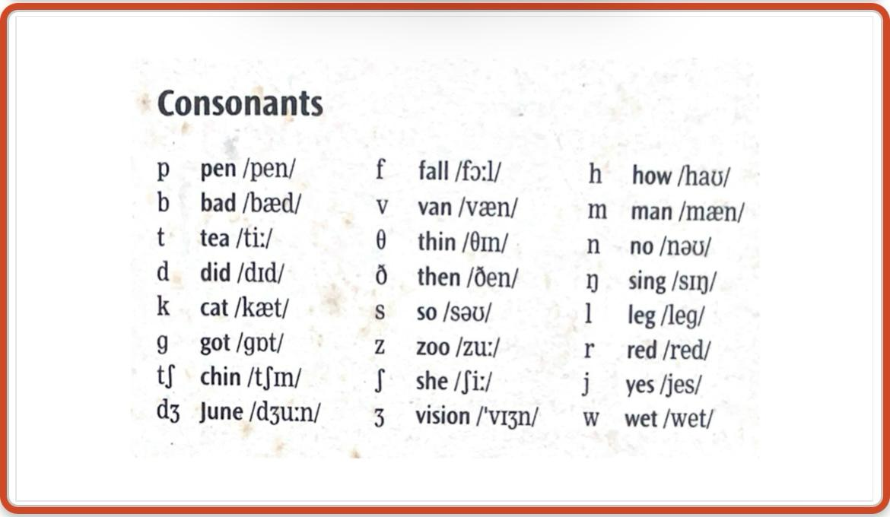
The following list contains the phonemic symbols for English consonant sounds. The spelling and the phonemic transcription of the words are given for better understanding.

Slide 12
Sounds often mispronounced
/z/ and /s/
PRACTICE: Articulate the words aloud to learn the difference of sounds written in bold.
Spelling | Phonemic Transcription
Advise Advice | /ədvaɪz/ /ədvaɪs/
Prize Price | /praɪz/ /praɪs/
Lose Loose | /luːz/ /luːs/
Rise Rice | /raɪz/ /raɪs/
Goose Goes | /gu:s/ /ɡəʊz/

Slide 13
Sounds often mispronounced
/v/ and /w/
/v/ articulated with lower lip and upper front teeth; /w/ articulated with rounded lips
PRACTICE: Articulate the words aloud to learn the difference of sounds written in bold.
Spelling | Phonemic Transcription
Vest ( West | /vest/ /west/
Vet Wet | /vet/ /wet/
Vine Wine | /vaɪn/ /waɪn/
Veil Whale | /veɪl/ /weɪl/

Slide 14
Sounds often mispronounced
/dʒ/, /z/
PRACTICE: Articulate the words aloud to learn the difference of sounds written in bold.
Spelling | Phonemic Transcription
Stage Stays | /steɪdʒ/ /steɪz/
Rage Raise | /reɪdʒ/ /reɪz/
Page Pays | /peɪdʒ/ /peɪz/
Reasons Regions | /riːzənz/ /riːdʒənz/

Slide 15
Sounds often mispronounced
/dʒ/, /z/, /ʒ/ and /ʃ/
PRACTICE: Articulate the words aloud to learn the difference of sounds written in bold.
Spelling | Phonemic Transcription
Reason Region Vision Mission | /riːzən/ /riːdʒən/ /vɪʒən/ /mɪʃən/
College Collage Coals Polish | /kɒlɪdʒ/ /kɒlɑːʒ/ /kəʊlz/ /pɒlɪʃ/
Gym Zoom Genre Shame | /dʒɪm/ /zuːm/ /ʒɒnrə/ /ʃeɪm/

Slide 16
Sounds often mispronounced
/eɪ/, /e/ and /æ/
PRACTICE: Articulate the words aloud to learn the difference of sounds written in bold.
Spelling | Phonemic Transcription
Pain Pen Pan | /peɪn/ /pen/ /pæn/
Main Men Man | /meɪn/ /men/ /mæn/
Rate Rest Rat | /reɪt/ /rest/ /ræt/
Day Then Than | /deɪ/ /ðen/ /ðæn/

Slide 17
/r/ In British pronunciation, /r/ sound is omitted if it occurs at the final position of a word, such as,
Spelling | Phonemic Transcription
Engineer | /endʒɪnɪə/
Doctor | /dɒktə/
Professor | /prəfesə/
Computer | /kəmpjuːtə/
but /r/ is pronounced if it is followed by a vowel sound, for example
Spelling | Phonemic Transcription
Engineering | /endʒɪnɪərɪŋ/
Doctorate | /dɒktərət/
Computerised | /kəmpjuːtəraɪzd/
Note: In American pronunciation, every 'r’ of the ordinary spelling is sounded.

Slide 18
Use of Articles (A/An)
We know that articles are used before singular countable nouns but where to use 'a' and where 'an' is a bit confusing at times.
The knowledge of finding out the difference between vowel and consonant sounds will help us use these articles correctly and confidently.
It is not the initial letter of a word that determines the use of A or An before it but the initial sound of that word. An is used only before a word that begins with a vowel sound.
Do not look at the spelling of a word but the initial sound.

Slide 19
Activity Pronounce the following words aloud. On the basis of the understanding of vowel and consonant sounds, use A or An before the words listed below:
______ house
______ hour
______ university
______ honest person
______European university
______ year
______ear
______LLB student
______ owl
______ school

Slide 20
Activity Read phonemic transcriptions of the following words. Pronounce them aloud and write their spellings.
Phonemic Transcription | Spelling
/teknɒlədʒi/
/endʒɪnɪərɪŋ/
/juːnɪvɜːsəti/
/məkænɪkəl/
/elektrɒnɪks/
/ˈɪŋɡlɪʃ/
/ɡræmə/
/stjuːdənt/
/ɑːtɪfɪʃəl ɪntelɪdʒəns/
/eɪ aɪ/

Slide 21
Activity Articulate the words listed below and transcribe them phonemically. Please note that phonemic transcription is written under slashes / /.
Spelling | Phonemic Transcription
Catch | / /
Fan
Laptop
Professor
Keypad
Chair
Ice
Air
Eyes
Canteen

Slide 22
For better and more enhanced learning and practice, go through the following references:
References
Balasubramanian, T. (1981). A textbook of English phonetics for Indian students. Macmillan.
Jones, D. (2011). Cambridge English pronouncing dictionary with CD-ROM. Cambridge University Press.

